Slide 1
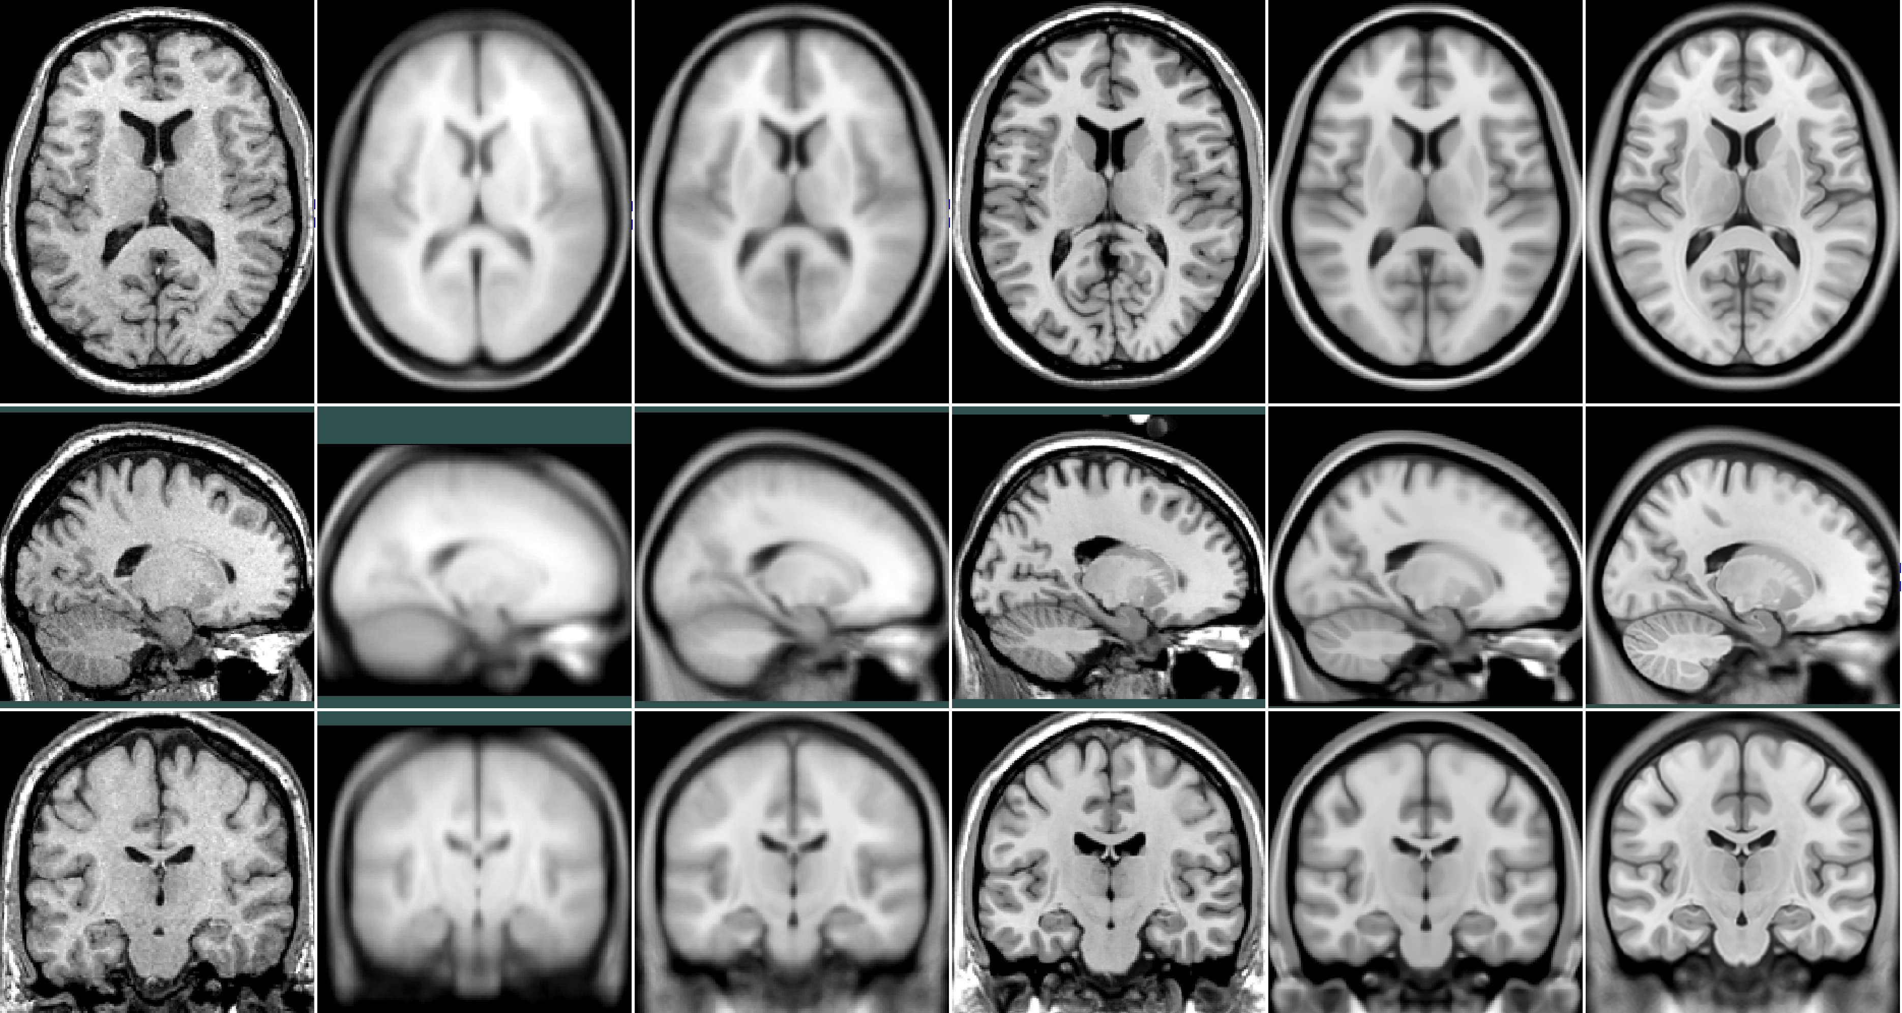
BIC Stereotaxic MRI Templates
Jacob
1992
MNI305
1994
MNI152 linear
1994
COLIN27
1998
MNI152 nonlinear
2001?
ICBM152 2009 nl
2009

