Slide 1
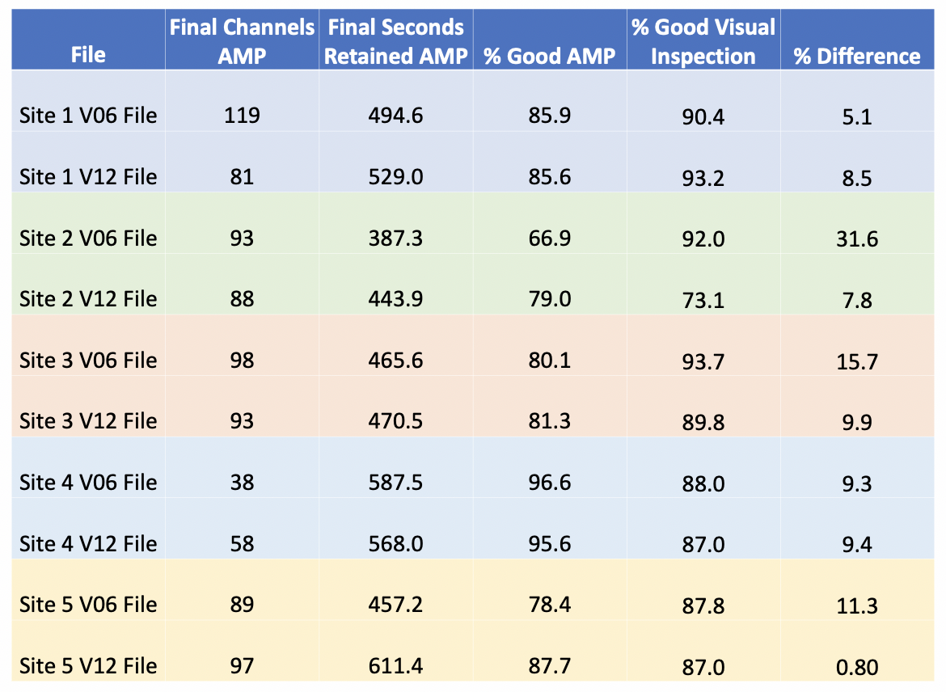
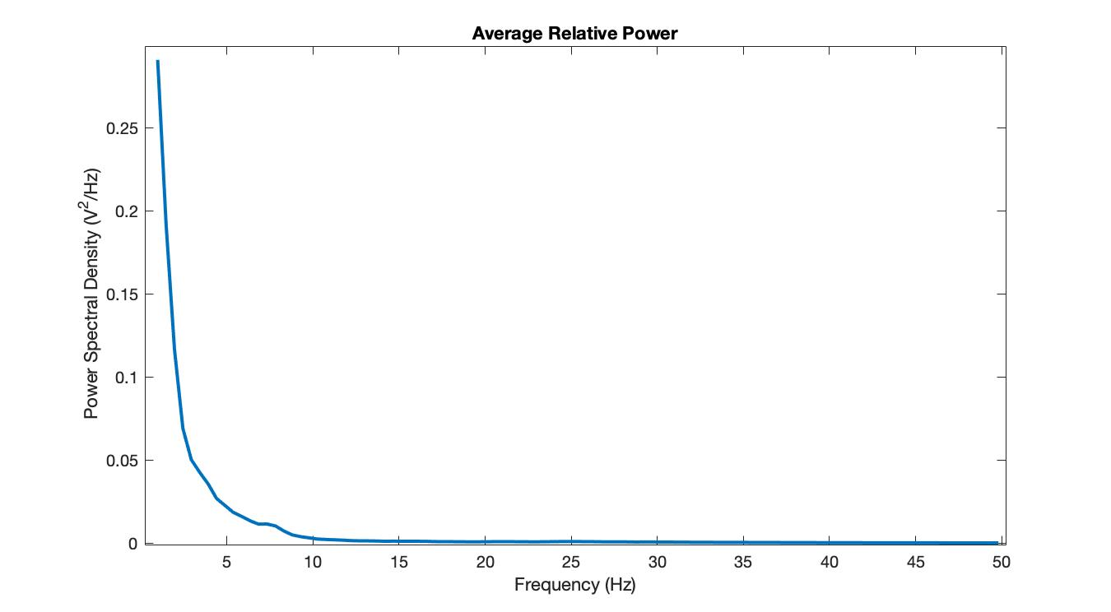
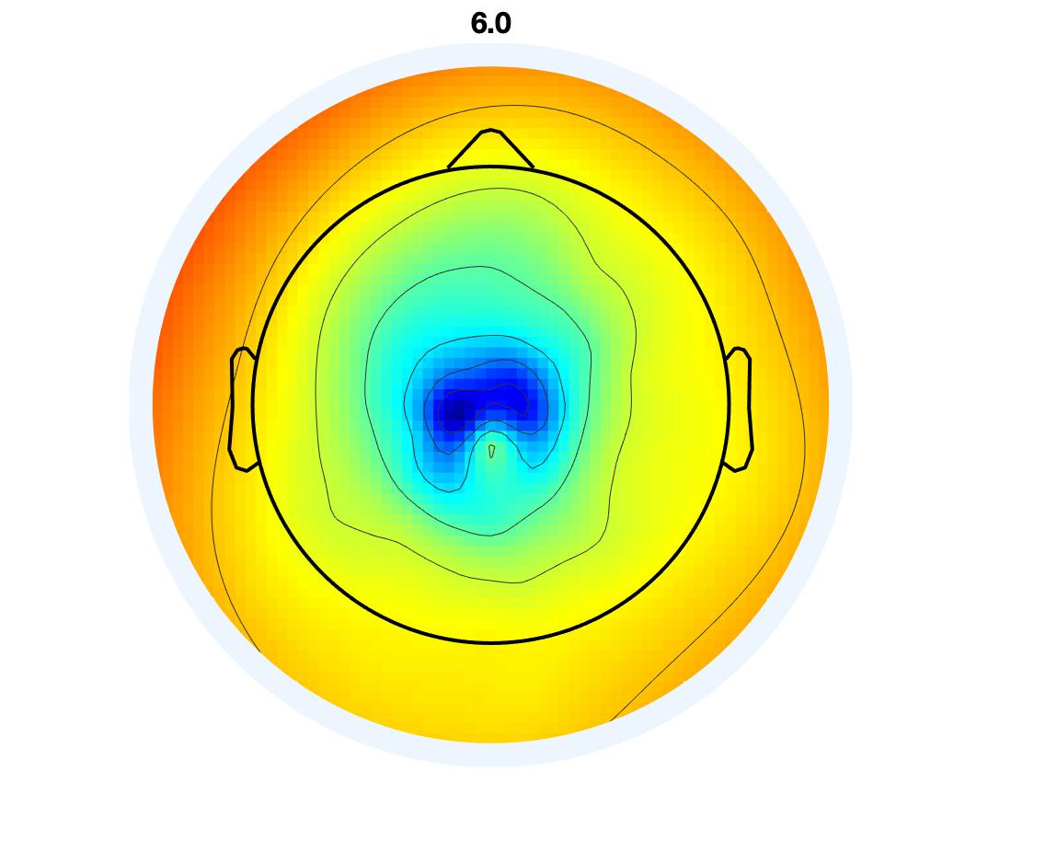
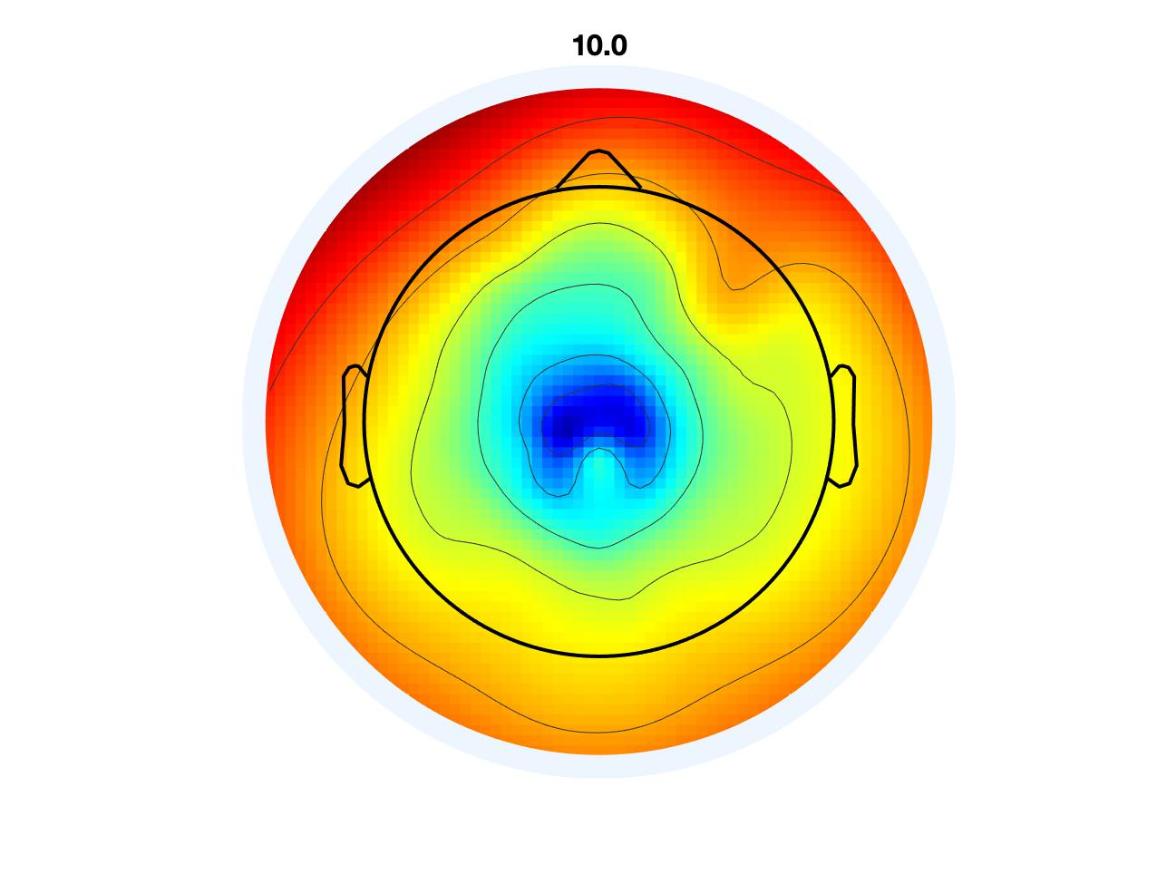
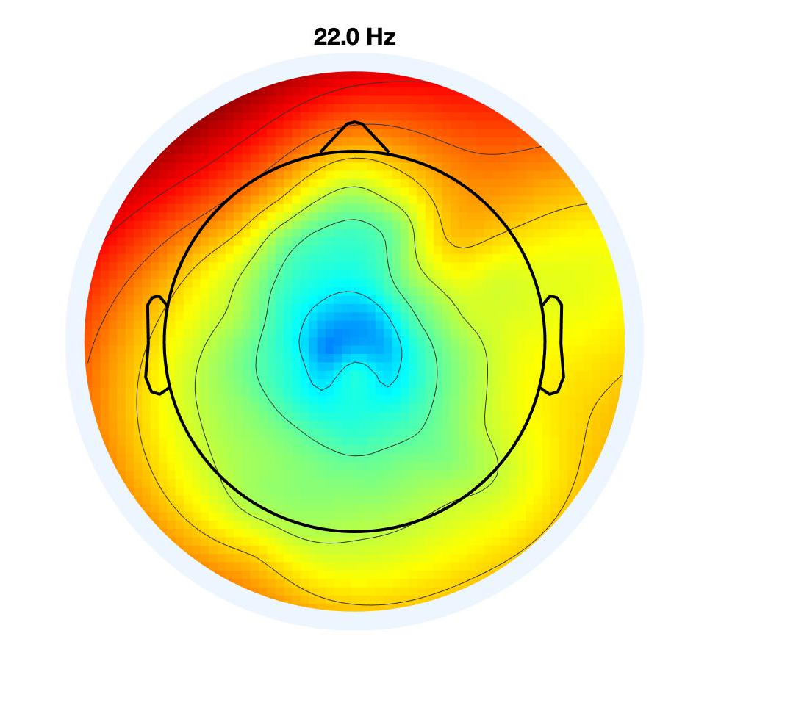
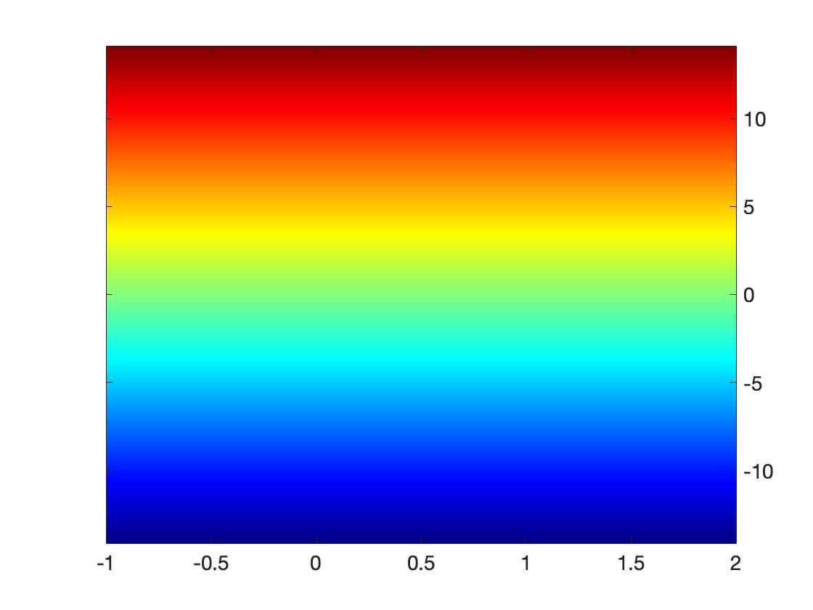
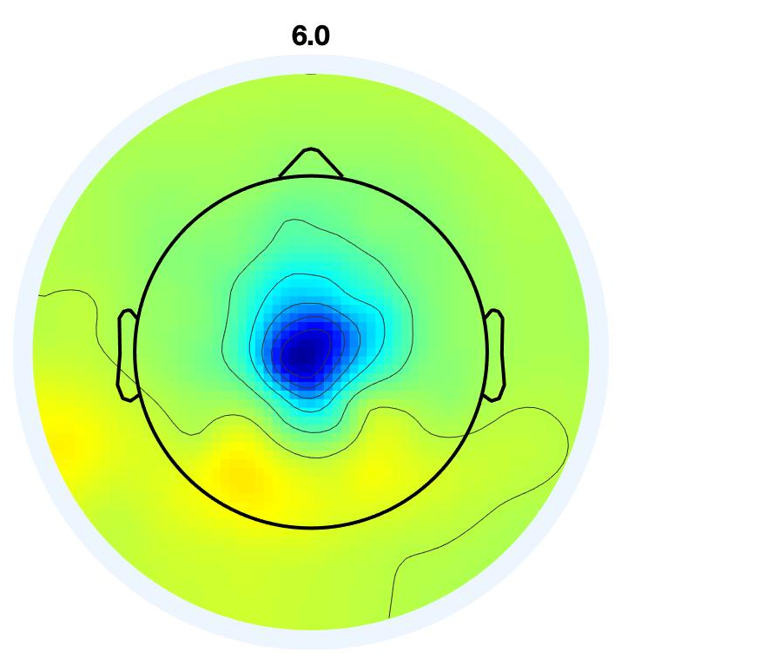
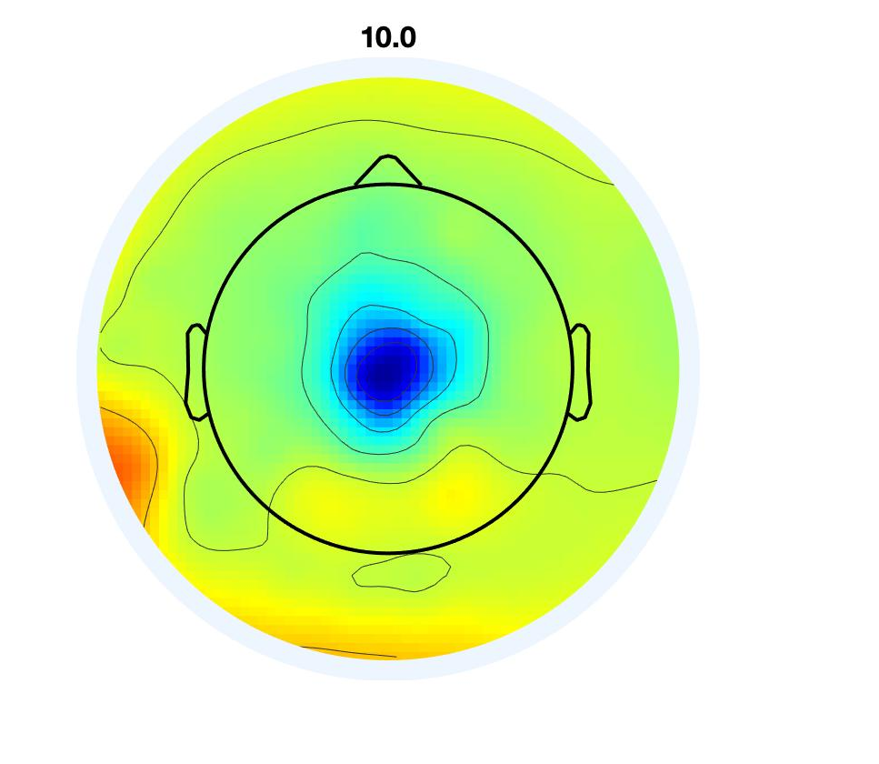
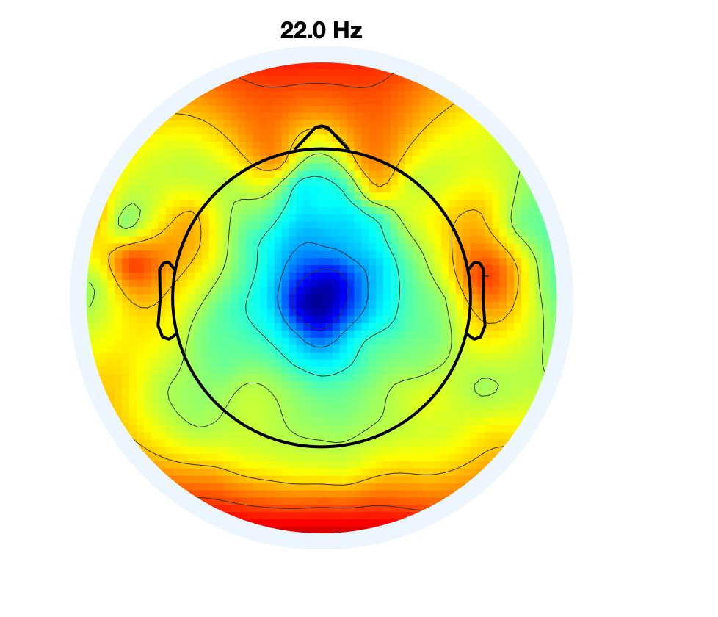
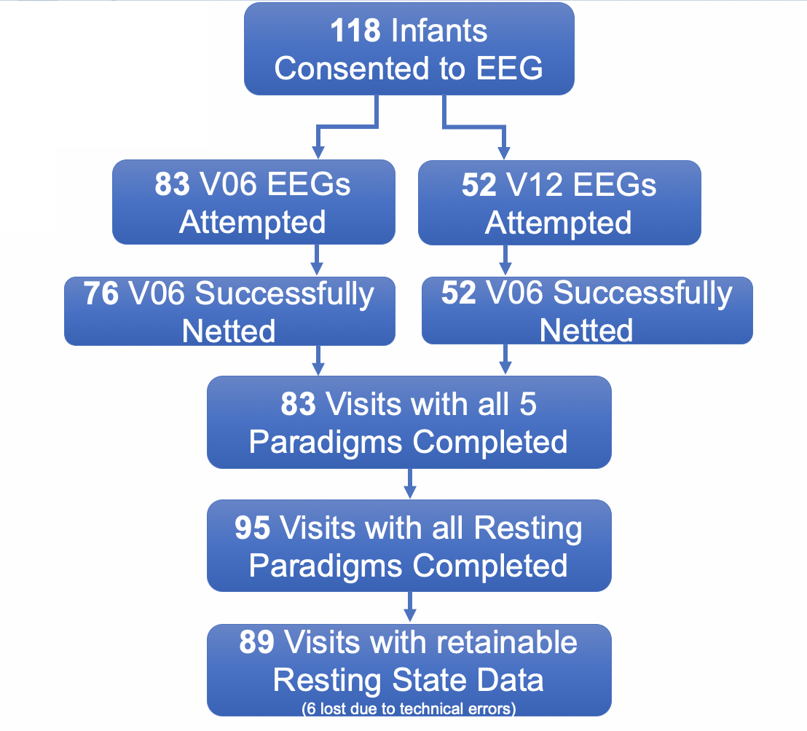
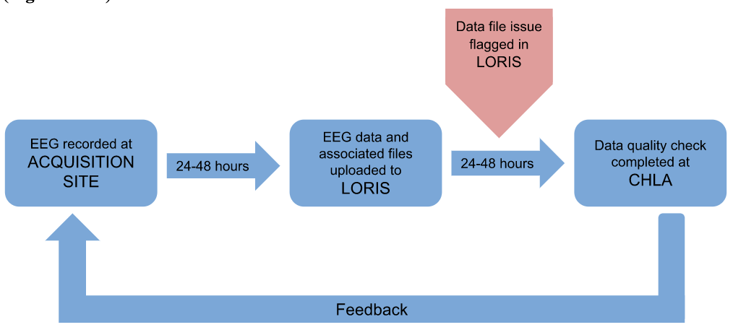
Methodological strategies for improving data quality and retention across multi-site studies of early EEG biomarkers in ASD
Madison Booth, Abigail Dickinson, Adrian Lee, Bonnie Lau, Alana Campbell, Jed Elison, Juhi Pandey, John Zempel, Annette Estes, Stephen Dager, Heather Hazlett, Jason Wolff, Robert Schultz, Kelly Botteron, Natasha Marrus, Leigh MacIntyre, Alan Evans, Joe Piven, John Pruett, & Shafali Jeste for the IBIS Network
Background
Infants with an older full sibling with ASD may have atypical development in the first year of life, with up to 15% of children developing ASD (also called high likelihood infants – HL)
The Infant Brain Imaging Study (IBIS) is a large scale, multisite study established to uncover brain patterns that may precede an ASD diagnosis in HL infants
Electroencephalography (EEG) provides a direct measure of brain activity and a scalable method to test biomarkers of neural synchrony and function in early infancy
Relatively little has been published on best practices for EEG data collection on infants with most studies discarding data from >50% of infant EEG recordings (Cuevas et al., 2014).
Rigorous methods are needed to ensure that EEG biomarkers are robust, scalable and reliable
Methods
Results
(2) Average percent of clean EEG data evaluated with visual inspection across all 89 visits
(1) Training and Setup Procedures
(1) Visual Inspection of EEG data highly correlates to automatic amplitude-based data cleaning code
Establish
Clearly establish best practices for EEG
Demonstrate
Demonstrate detailed techniques to maximize data quality
Provide
Provide strategies to promote comfort and ease of participation for infants and families.
(2) Standardization of Data Recording Methods
(3) Relative power averaged across all channels within the 10 above mentioned infant EEG files
EEG recordings consisted of 3 resting state blocks, visual and auditory evoked potential ERP paradigms
All sites were provided with an IBIS specific laptop to assist in standardization of recoding procedures across sites and reduce the risk of contamination from other studies
(4) Power spectral density (PSD) plot shows spontaneous brain generated signals during resting state EEG in both 6- and 12-month-olds
Objectives & Challenges
a) 6-month-old
b) 12-month-old
Establish a standardized protocol to acquire EEG data across a population of 250 HL infants
Maximize data quality and retention using a standardized protocol across all sites
All sites varied with EEG data collection expertise
Variability across each lab’s available technology
Time sensitive and valuable population
(3) Post Processing and Data
Quality Checks
Conclusions & Future Directions
All sites continue to collect high quality EEG data with retention rates over 60% across all infants and all resting state blocks.
Internal QC checks are validated by an automatic, amplitude-based EEG cleaning code.
Inspection of spontaneous resting EEG data demonstrates EEG activity arose from brain-generated signals rather than environmental noise or muscle movement
These same methods will be applied to event related EEG
Visual inspection remains the gold standard of evaluating EEG data quality.
Need ways to objectively demonstrate the success of our methods when quality control is inherently a subjective measure
References & Funding Cuevas, K., Cannon, E. N., Yoo, K., & Fox, N. A. (2014). The Infant EEG Mu Rhythm: Methodological Considerations and Best Practices. Developmental review : DR, 34(1), 26–43. Van der Velde, Bauke, and Caroline Junge (2020). “Limiting Data Loss in Infant EEG: Putting Hunches to the Test.” Developmental Cognitive Neuroscience, vol. 45, p. 100809. Stoyell et al., (2021). High-Density EEG in Current Clinical Practice and Opportunities for the Future. Journal of clinical neurophysiology : official publication of the American Electroencephalographic Society, 38(2), 112–123. DiStefano et al., (2019). EEG Data Collection in Children with ASD: The Role of State in Data Quality and Spectral Power. Research in autism spectrum disorders, 57, 132–144. National Institute of Mental Health (RO1MH121462, PIs: Jeste & Elison)

